Slide 1
Digital Modes with HF
Presented by Jeff McGrath N1SC
October 26th 2017 - Sandy City ARC Meeting

Slide 2
I took notes for you already!
tinyurl.com/n1sc-sandy
(case sensitive)
(includes information sources)

Slide 3
FT-8, JT65, JT9, MSK144, WSPR, PSK31, & More!
( What did he just say? )
More of the “How To”
Less of the “How does it work”

Slide 4
Two “Categories”
Timed & Not Timed
Some modes require accurate time for FEC.
Some modes require no time coordination.

Slide 5
Timed
JT65, JT9, FT-8, WSPR, MSK144
Using WSJT-X, JTDX

Slide 6
Not Time Based
PSK31, MFSK, Olivia, RTTY
THOR, MT63, Contestia, CW
Using FLDigi

Slide 7


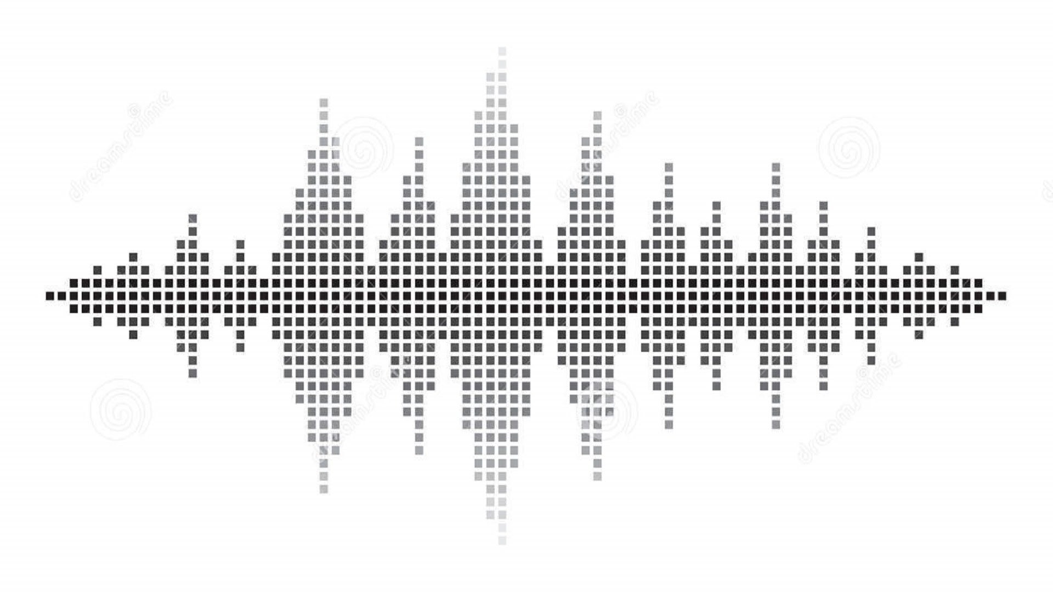
Stepping back - Looking at Voice
Upper Side Band | Lower Side Band | FM | AM
Voice Audio
Voice Audio

Slide 8


Slide 9

What’s the difference?
The Computer is making the noises now, not the human!
Making actual, audio waves, with the sound card.
Computer Audio
Computer Audio

Slide 10
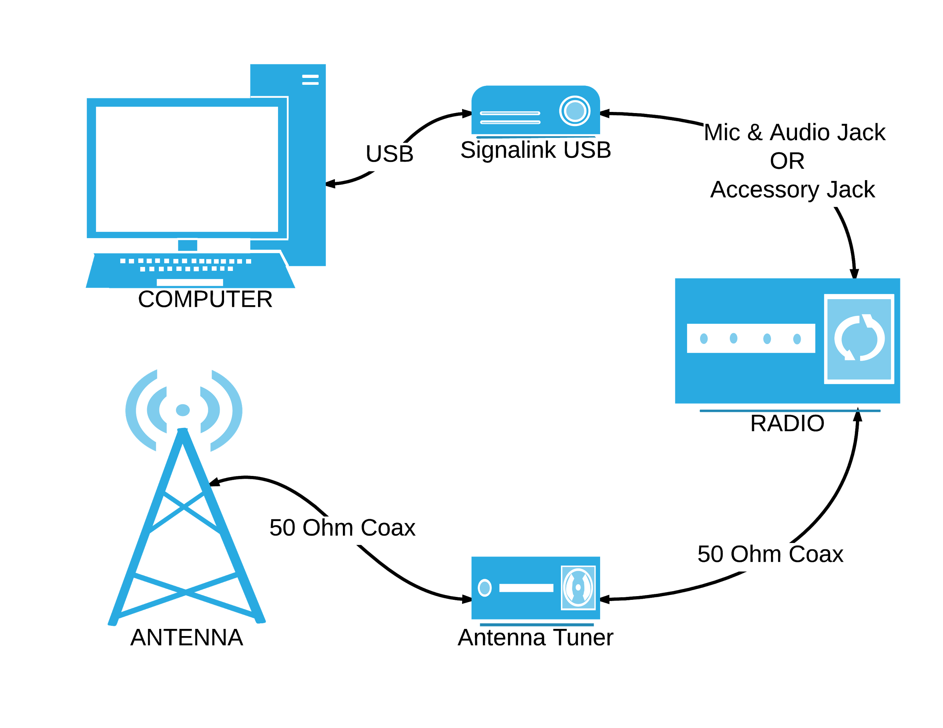

Slide 11
What do we need?
A Transceiver Radio
Computer
A Sound Card (Input and Output)
  Signalink (External Sound Card)
Cables
Software
Ham Radio License
Internet or a portable GPS based NTP server

Slide 12
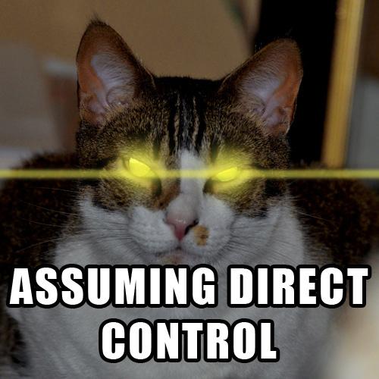
CAT Control

Slide 13

CAT Control
Software such as HRD Ham Radio Deluxe
CAT Control inside of FLDigi
CAT Control inside of WXJT-X, WOO HOO
Uses HamLib
Changes Frequencies, Accurate Spotting, All the Things!

Slide 14
License
Make sure you are operating within the privileges of your license.

Slide 15
WSJT-X
Let’s start looking at some of these
time synced modes….

Slide 16
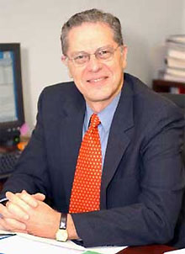
Created by
Joseph Taylor Jr.
(K1JT)
American astrophysicist and Nobel Prize in Physics.
First licensed as a teenager.
Also licensed in Australia at one point in time.

Slide 17
Honors and Awards
Heineman Prize of the American Astronomical Society (1980)(inaugural)
Fellow of the American Academy of Arts and Sciences (1982)
Henry Draper Medal of the National Academy of Sciences (1985)
Tomalla Foundation Prize (1987)
Magellanic Premium (1990)
Albert Einstein Medal (1991)
John J. Carty Award for the Advancement of Science of the National Academy of Sciences (1991) (physics)
Wolf Prize in Physics (1992)
Nobel Prize in Physics (1993)
Karl Schwarzschild Medal (1997)
Taylor was among the first group of MacArthur Fellows. He has served on many boards, committees, and panels, co-chairing the Decadal Panel of that produced the report Astronomy and Astrophysics in the New Millennium that established the United States's national priorities in astronomy and astrophysics for the period 2000-2010. He was a guest of honor in the 2009 International Physics Olympiad.
Wikipedia 2017/03

Slide 18
Nobel Prize in Physics
Laureate for with Russell Alan Hulse of a "new type of pulsar, a discovery that has opened up new possibilities for the study of gravitation."

Slide 19
“Weak Signal Joe Taylor”
(WSJT-X)
Weak Signal - Not Weak Power
Great for compromised antennas and QRP!
(doesn’t have to be QRP though)

Slide 20
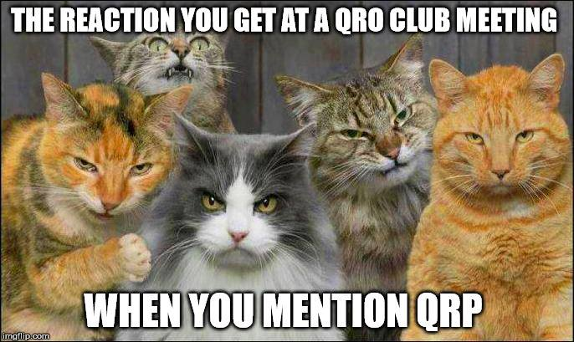

Slide 21
Modes on WSJT-X 1.7.0
JT4 Microwave
JT9 (HF/MF) 2db more sensitive
JT65 (EME) VHF/UHF
QRA64 (EME) VHF/UHF … it’s better
ISCAT (fast) for meteor & airplane scatter
MSK144 (fast) for meteor & airplane scatter
WSPR Weak Signal Propagation Reporter
Echo measure your own station’s echos bouncing off the moon

Slide 22

Modes on WSJT-X 1.8.0rc3
FT-8 (6 meter, sporadic-e)

Slide 23
FT-8
Used to use the KVASD decoder
Now use the FT Decoder (Frank Taylor)
JT65 source-encodes all messages to 72 bits and uses 6-bit symbols (72/6=12), and only uses a 64 character alphabet.
50 Hz
S/N to –20 dB (-50 +49dB theoretical)
Low False Decodes
13 seconds each TX/RX, 1m 15s total (6m)
Sporadic E - 6 meters

Slide 24
JT65
Used to use the KVASD decoder
Now use the FT Decoder (Frank Taylor)
JT65 source-encodes all messages to 72 bits and uses 6-bit symbols (72/6=12), and only uses a 64 character alphabet.
177.6 Hz for JT65A
JT65 –1 to –30 dB
JT65 clamped at an upper limit –1 dB
Low False Decodes
50 seconds each TX/RX, 5 minutes total (6m)

Slide 25
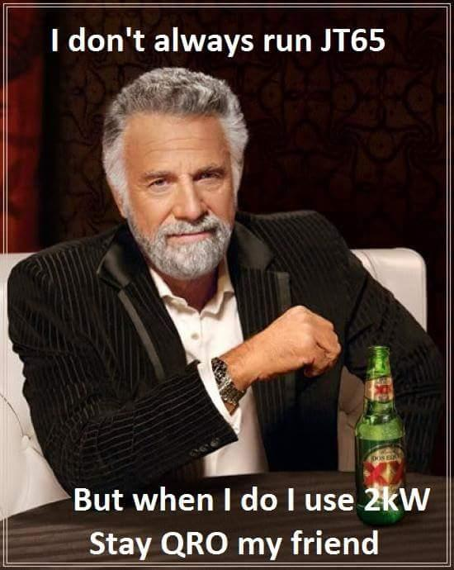

Slide 26
JT9
Used to use the KVASD decoder
Now use the FT Decoder
Messages to 72 bits
6-bit symbols / 64 character alphabet.
JT9: 15.6 Hz wide
S/N = –22 dB and about 50% at –24 dB.
JT9 is about 2 dB better
Achieving 50% decoding at about –26 dB.
Low False Decodes
More in 3Khz bandwidth
Also 1 minute TX/RX

Slide 27
MSK144
Meteor Scatter
Airplane Scatter
Superman Scatter
5, 10, 15 or 30 Second Segments
Ping Jockey
28 Characters Long
Hashed Messages
250 characters per second
Patience
POWER
Yagis

Slide 28
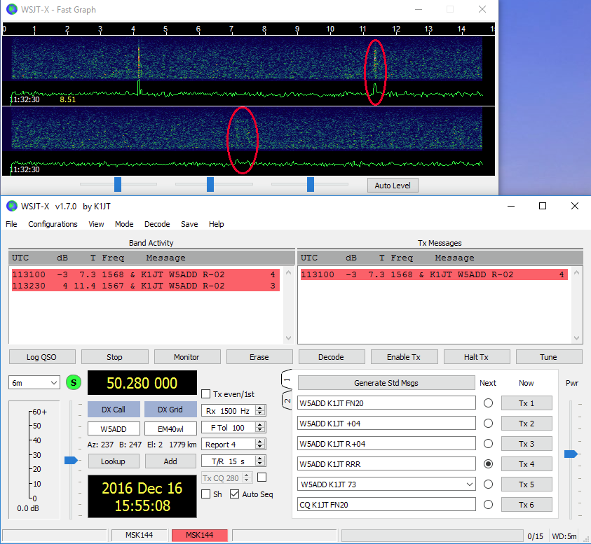
MSK144
Two 15 Second MSK144 blips
6 Meters

Slide 29
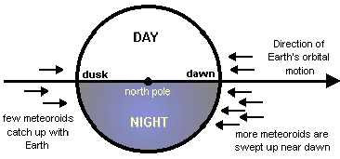
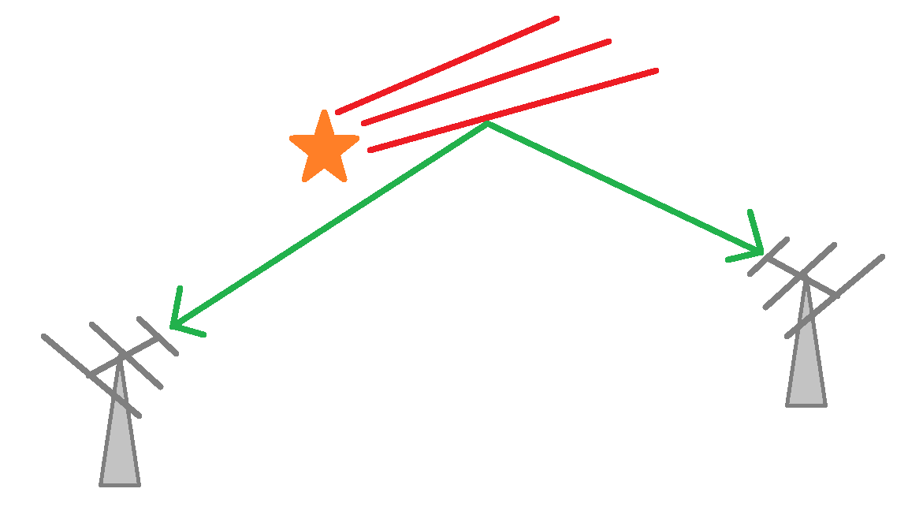
Meteor Scatter

Slide 30
WSPR
2 minutes
QRP (less than 5 watts)
-28 dB in a 2500 Hz bandwidth
WSPRnet
http://wsprnet.org/drupal/
NO EXCHANGES…. huh?!

Slide 31
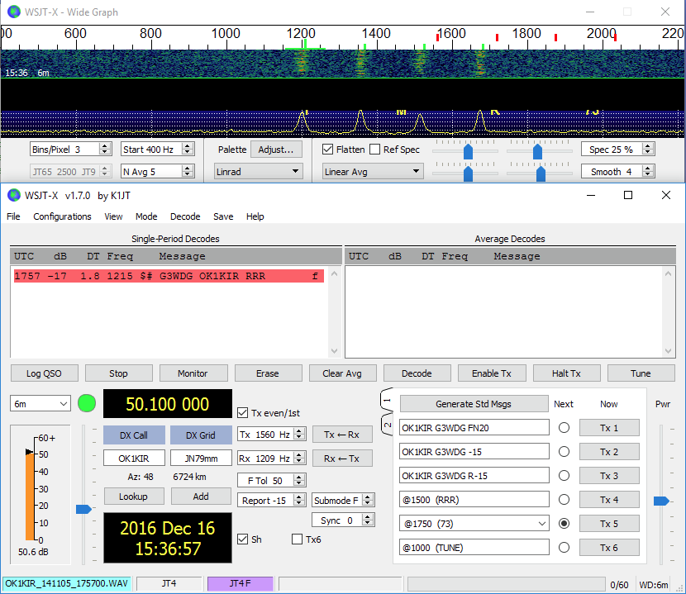
JT4
EME
2.3GHz to 10GHz
60 Seconds

Slide 32
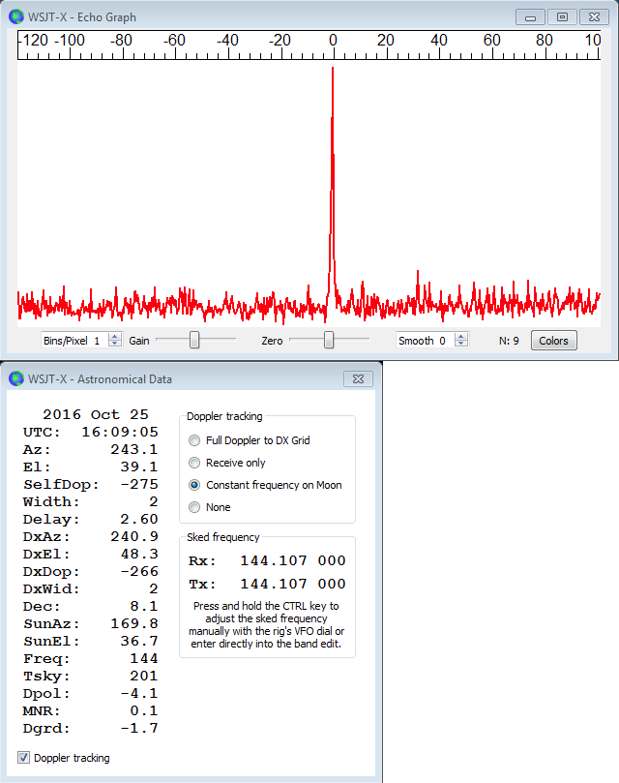
Echo
EME Test
Transmit a 1500 Hz fixed
tone for 2.3 s
Wait about 0.2 s for start
of the return echo
Record the received
signal for 2.3s

Slide 33
Non-Timed Modes

Slide 34
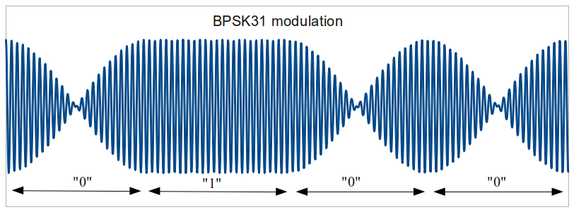
PSK31
Phase Shift Keying, 31 Baud
No FEC
Designed to fight QSB
Chosen because of “Normal Typing Speed”
Look at the Seventies! 20 and 40 meters:
  7.070 MHz (USB)
  14.070 MHz (USB)

Slide 35
MFSK
Multiple frequency-shift keying
Can be used with various methods of FEC
Robust against noise and QSB
Hard to find contacts
Modes:
  MFKS32
  Olivia
  Contestia
  JT65
  FSK144
  WSPR

Slide 36
Now you’re all experts and ready to take off...

Slide 37
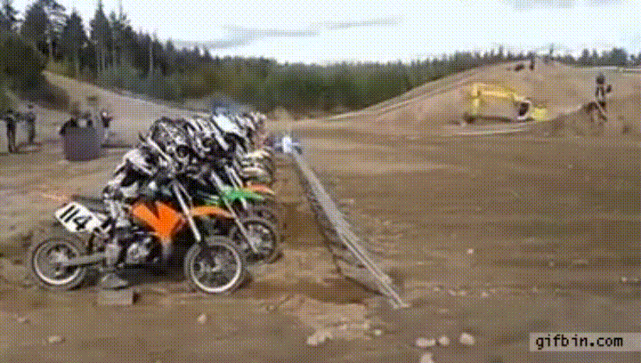

Slide 38
Okay, that’s nice an all,
but how do you use the freaking thing?

Slide 39
The Software...
FLDigi
WSJT-X

Slide 40
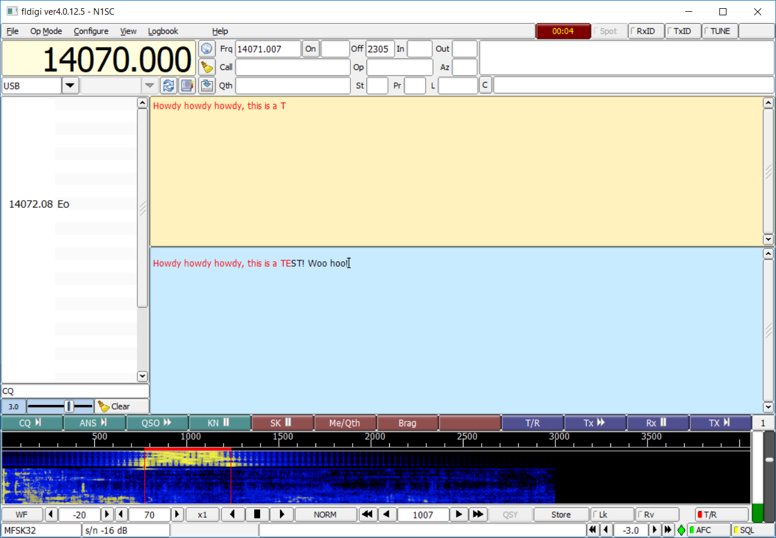
FLDigi

Slide 41
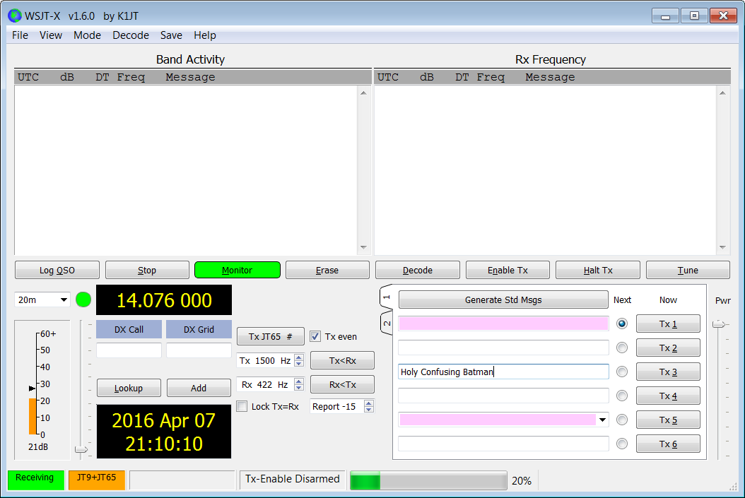
WSJT-X

Slide 42
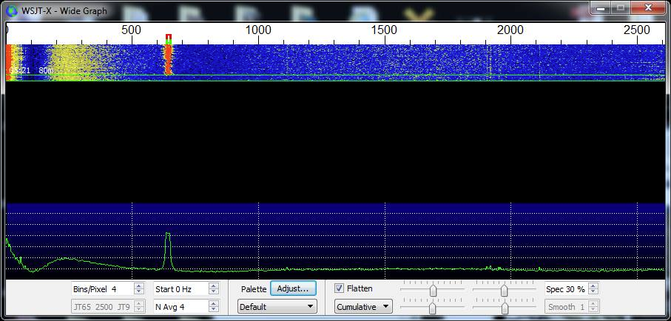
Bandwidth & Waterfall
JT9 occupies less than 16 Hz bandwidth!!! Holy Cow that’s Narrow!

Slide 43
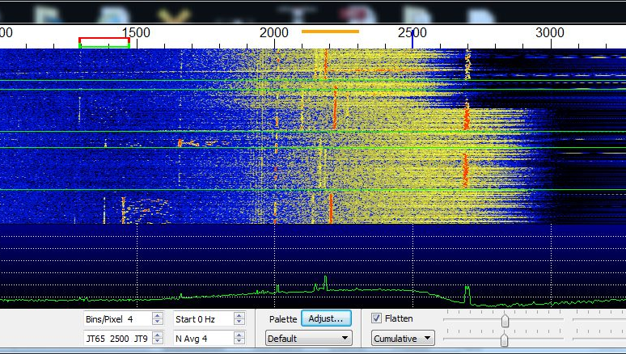
Filtering Strong Signals
Hi Cut & Low Cut
Notch Filter
Bandwidth 3KHz, 6KHz?
5 JT65 Signals
1 screaming JT9

Slide 44
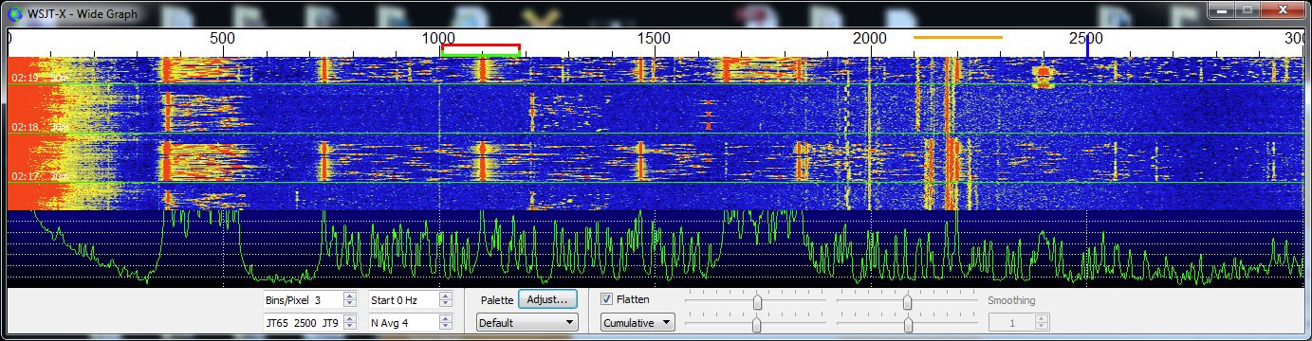
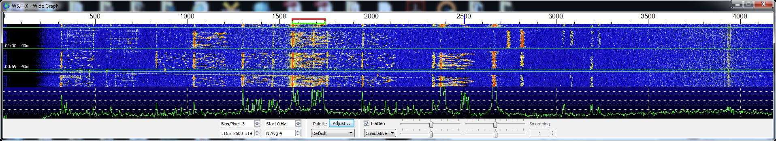
Power and Splatter
Kittens Die When You Don’t Watch Your ALC
“An Automatic Level Control (ALC) circuit governs the signal strength going into the power amplifier in a ham radio transmitter. It keeps the amplifier input in the designed range for linear operation.” - hamradioandvision.com

Slide 45
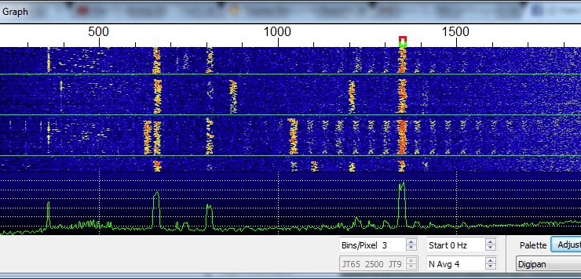
Look at that Splatter!
Bad ALC, Bad!

Slide 46
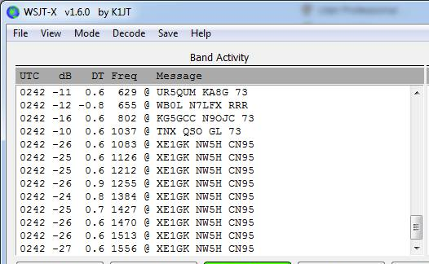
Look at that Splatter!

Slide 47
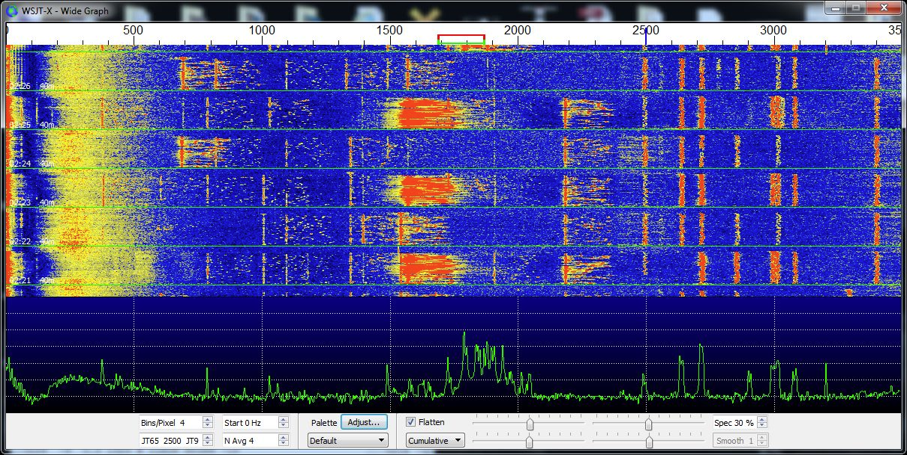
What is WSJT-X Telling Us?!?!?!?!

Slide 48
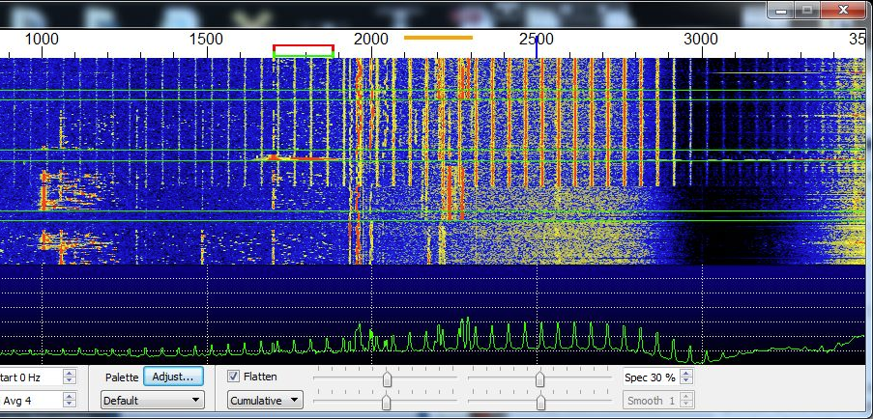
RFI - Something else you might encounter

Slide 49
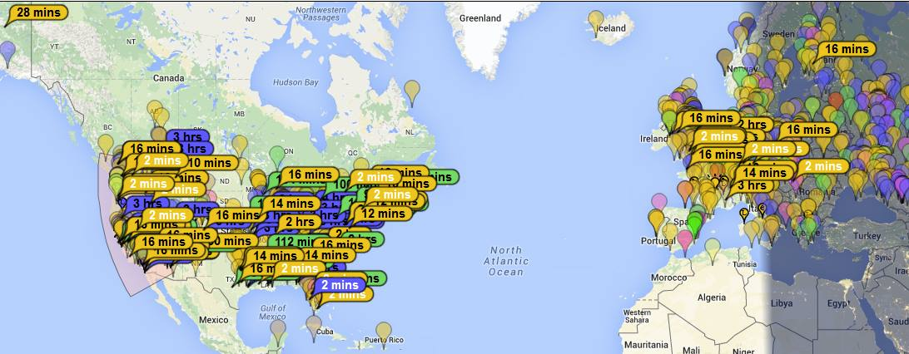
Am I getting out?
PSKReporter.info
https://www.pskreporter.info/pskmap.html?preset&callsign=WE7CB&timerange=86400

Slide 50
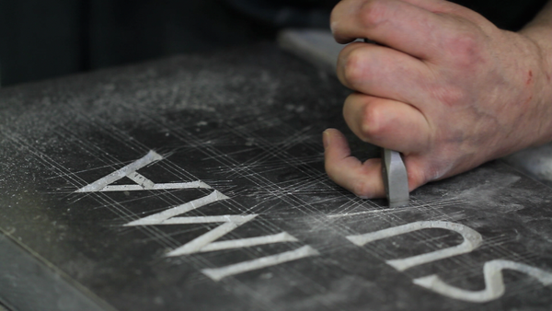
Confirming & Logging
N3FJP - Amateur Contact Log
QRZ
LOTW
eQSL
JTAlert
WSJT-X
FLDigi
HRD
Stone and Chisel

Slide 53
Additional Tools
JT Alert
Dimension 4 (You’ll need internet!)
(Syncing about your time is important!)

Slide 54
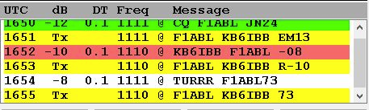
Sync’d Time - Delta
+3 Seconds, No Decode!

Slide 55
Common Frequencies
JT65 JT9 PSK31
7.076.000 7.078.500 7.070.000
14.076.000 14.078.500 14.070.000

Slide 56
The Exchange
CQ N1SC DN40
N1SC WE7CB -18
WE7CB N1SC R-10
N1SC WE7CB RRR
WE7CB N1SC 73
N1SC WE7CB 73
CQ N1SC DN40

Slide 57

Demo Time
Demo Time

Slide 58
Let us actually show you…
For real…
I’m not kidding...

Slide 59
dit dit

